Slide 1
Environmental Sound Classification And Data Augmentation
Minor Project Evaluation
Semester: VIth
Mentor:
Mr. Abhay Kumar
Students:
Mohnish Satidasani(1806046)
Aayush Hindwan(1806082)
Arpit Gupta(1806140)
Notes:
What is this

Slide 2

Urban Sound 8k DataSet
Features:
8732 audio files(.wav)
10 folds
10 categories
Categories:
Dog Bark
Children Playing
Air Conditioner
Street Music
Siren
Engine Idling
Jackhammer
Drilling
Gun Shot
Car Honk
Examples
DataSet Used

Slide 3
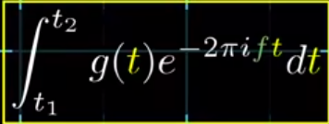
Technical details about dataset
( A quick background before pre-processing )
Audio is a vibration that propagates as an acoustic wave through a transmission medium.
.Wav audio format is uncompressed audio in the linear pulse code modulation (LPCM) format.
Sampling Rate is number of samples per sec taken from a continuous signal.
Time Domain data is RMS value of amplitudes over all frequencies on time axis.
Frequency Domain amplitude of sound on frequency axis(no info about time).
Then how to manage both time and frequency ??

Slide 4
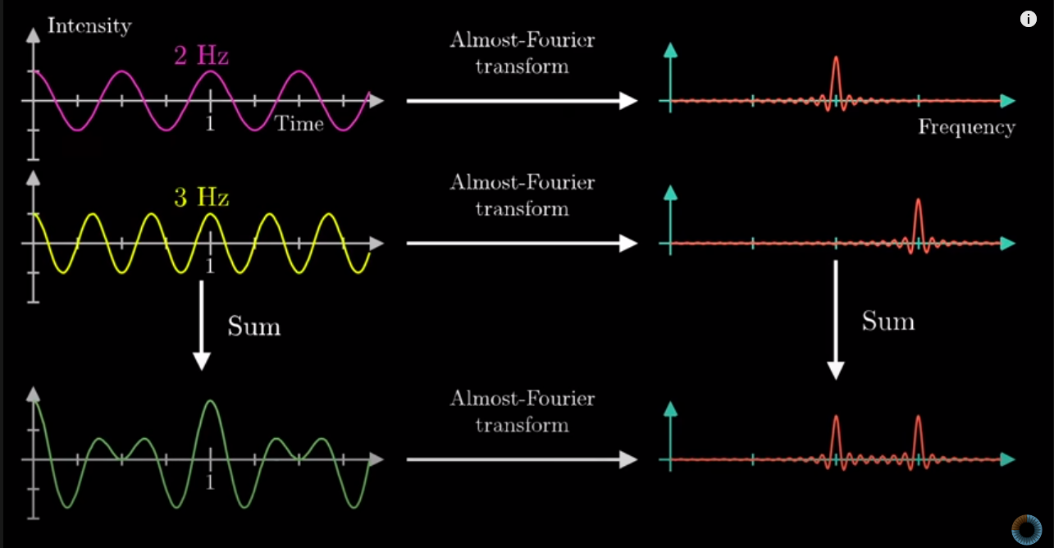
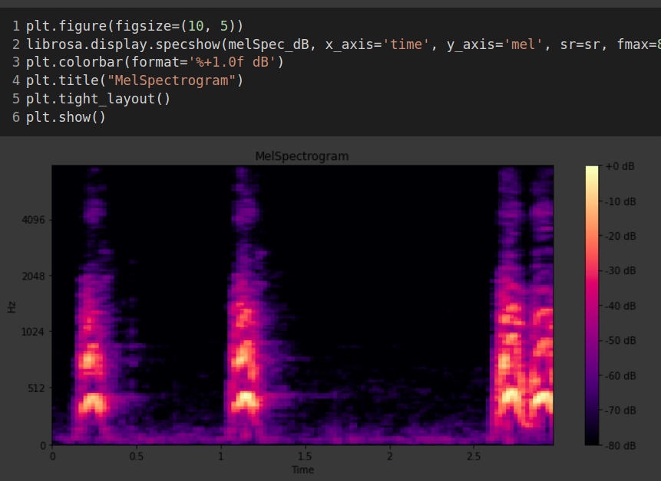
Data Pre-processing
Mel scale Spectrogram
FFT Fast Fourier Transform
STFT Short time fourier Transform
Spectrogram STFT of audio data along time axis
Mel Scale is a scale of pitches judged by listeners
Final Data Shape 128X128 (sr 22050hz)

Slide 5
Data Augmentation
Rotate Matrix
Observation:Shifting of Melspectrogram don’t change the class of sound.
This is used to generate more data.
Time Scaling
0.81x, 0.93x, 1x, 1.07x, 1.23x
Add Noise
Pitch Shifting
Random Combinations

Slide 6
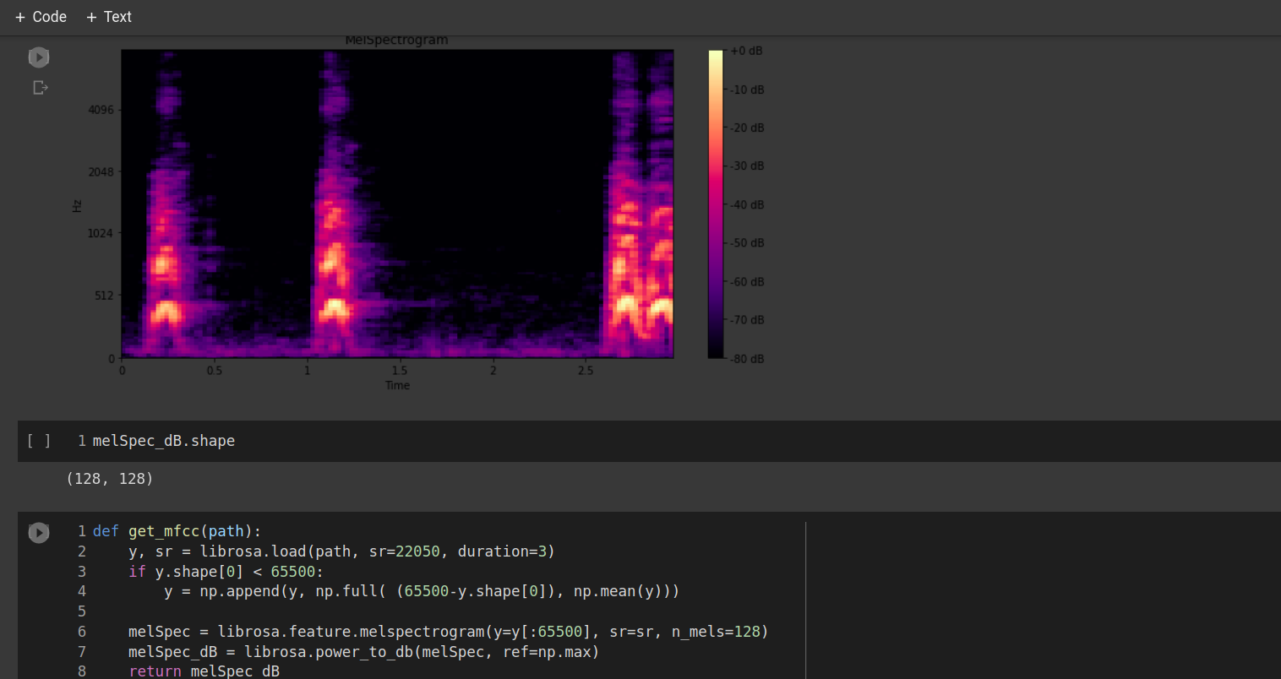

Slide 7
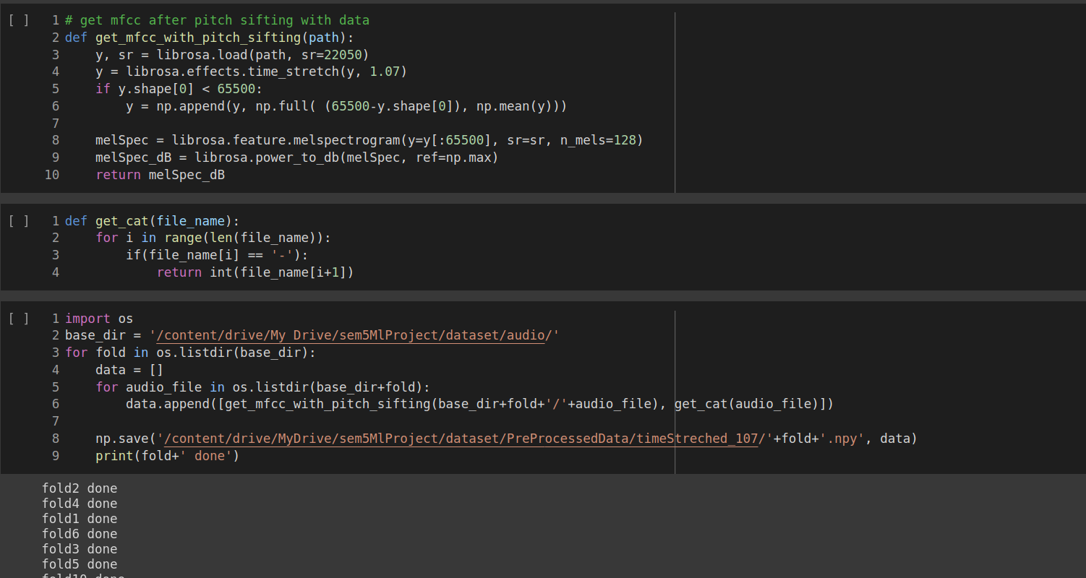

Slide 8
Model: in paper
Model Input 2d matrix of 128*128 over 3 seconds and frequency and intensity table.
Given our input X, the network is trained to learn the parameters Θ of a composite nonlinear function F(·|Θ), which maps
X to the output (prediction) Z
Z = F(X|Θ) = fL (··· f2 (f1 (X|θ1 )|θ2 )|θL ) (1)
where each operation f (·|θ ) is referred to as a layer of the network, with L = 5 layers in our proposed architecture.The first three layers, ∈ {1, 2, 3}, are convolutional, and expressed as
Z = f (X |θ ) = h(W ∗ X + b), θl = [W, b] (2)
where X is a three-dimensional (3-D) input tensor consisting
Note that the kernels are 3 dimensional.

Slide 9
Model Description Contd.:
The proposed CNN architecture is parameterized as follows:
1) 1 : 24 filters with a receptive field of (5,5), i.e., W has the shape (24,1,5,5). This is followed by (4,2) strided max- pooling over the last two dimensions (time and frequency, respectively) and a rectified linear unit (ReLU) activation function h(x) = max(x, 0).
2) 2 : 48 filters with a receptive field of (5,5), i.e., W has the shape (48, 24, 5, 5). Like 1 , this is followed by (4,2) strided max-pooling and an ReLU activation function.
3) 3 : 48 filters with a receptive field of (5,5), i.e., W has the shape (48, 48, 5, 5). This is followed by an ReLU activation function (no pooling).
4) 4 : 64 hidden units, i.e., W has the shape (2400, 64), followed by an ReLU activation function.
5) 5 : 10 output units, i.e., W has the shape (64,10), followed by a softmax activation function.

Slide 10
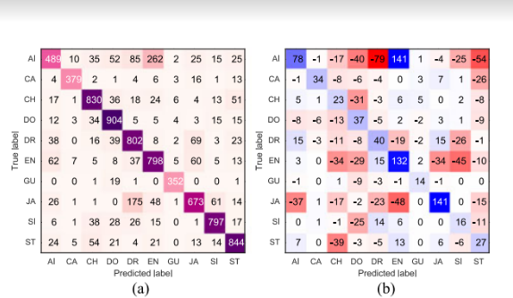
Model Description Contd.:
Adam Optimizer with learning rate 0.001 and epsilon 10^-6
L2 regularisation applied with a penalty factor of 0.001
Epochs used :100 with batch size 500 and is checkpointed after each epoch.
A validation set is used with a split of 30 % on overall dataset. Confusion Matrix

Slide 11
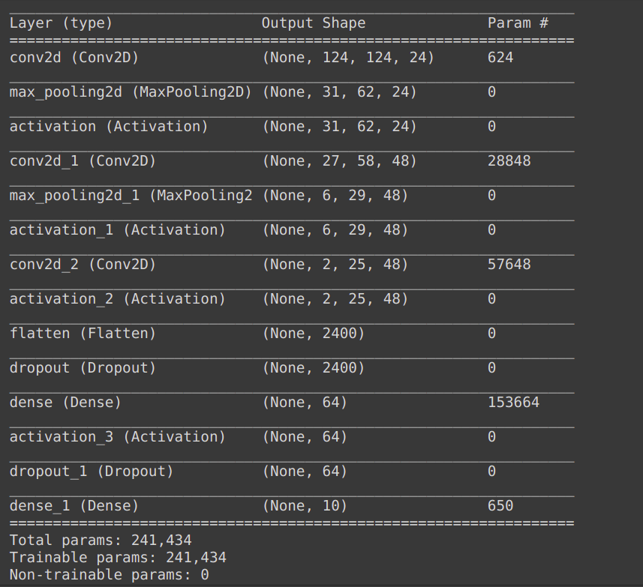
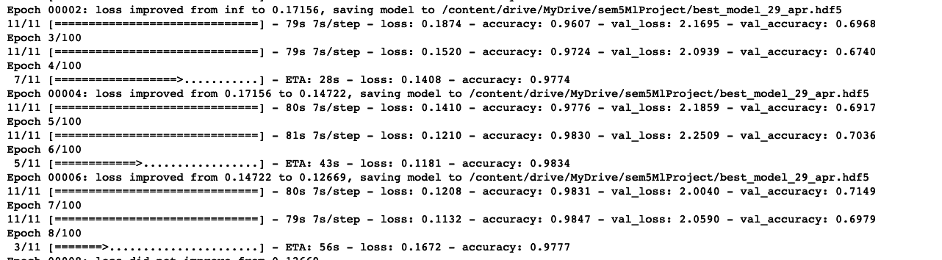
Model: we used

Slide 12
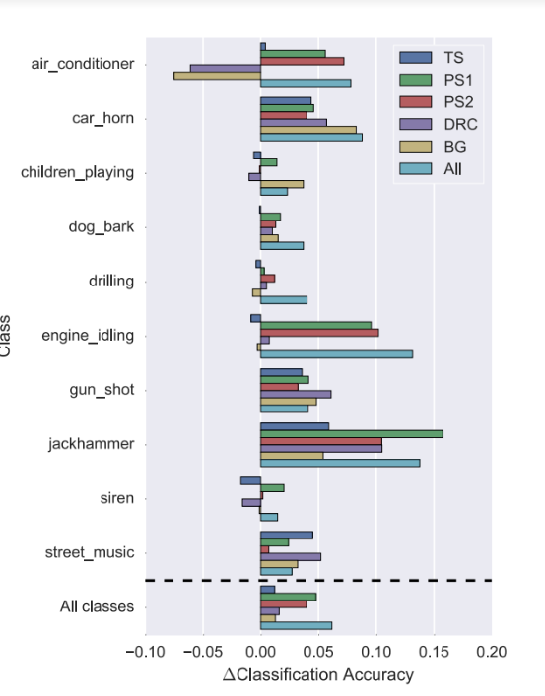
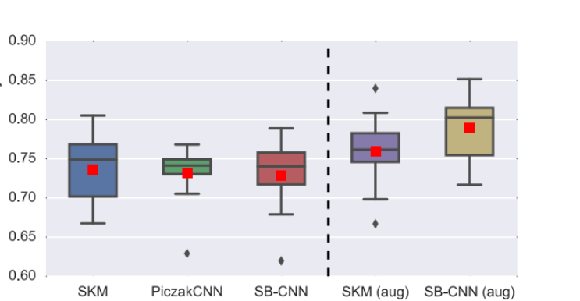
Results

Slide 13
REFRENCES
https://ieeexplore.ieee.org/document/7324337
https://www.sciencedirect.com/science/article/abs/pii/S0378437119314955
TensorFlow/Keras
Librosa for Preprocessing
https://paperswithcode.com/task/environmental-sound-classification

Slide 14
Qustions and Suggetions
please

